Slide 1


Matias Herrera Muñoz
20-06-2025

Slide 2

Outline
Executive Summary
Introduction
Methodology
Results
Conclusion
Appendix

Slide 3
Executive Summary
Goal: Predict Falcon 9 first-stage landings to support launch cost estimation for Space Y, using public SpaceX data.
Methodology: Cleaned and explored data; trained ML models including Decision Tree (best accuracy: 88.9%); built interactive dashboards.
Key Insights: Landing success improves with flight number; KSC LC-39A has the highest success rate; SSO orbits had 100% success over multiple launches

Slide 4

Introduction
The rise of commercial spaceflight has made launch costs a key competitive factor. SpaceX leads the industry by reusing the Falcon 9’s first stage, significantly lowering launch prices compared to other providers. However, not all missions recover the first stage. This project simulates the role of a data scientist at “Space Y”, a competitor aiming to estimate launch costs and predict first-stage landings using public SpaceX data.
Key Question:
Can we predict if the first stage will land successfully?
What features most influence landing success?
How do launch sites and orbits affect outcomes?
Can we build interactive dashboards to support decisions?
Allon Mask
My boss

Slide 5

Section 1

Slide 6
Methodology
Executive Summary
Data collection methodology:
API of the SpaceX data site.
WebScrapping from Wikipedia.
Perform data wrangling
Data Cleaning and Filtered
Perform exploratory data analysis (EDA) using visualization and SQL
Perform interactive visual analytics using Folium and Plotly Dash
Perform predictive analysis using classification models
Data Standardization trough a One-Hot Coding.

Slide 7
Data Collection
The data was collected with two different methods:
API: The data was collected from the API https://api.spacexdata.com/v4/launches/past
You need to present your data collection process use key phrases and flowcharts

Slide 8
Data Collection – SpaceX API
The Data was called using the request function, then with pandas I built the DataFrame.
The DF is composed by the columns: FlightNumber, Date, BoosterVersion, PayloadMass, Orbit, LaunchSite, Outcome, Flights, GridFins, Reused, Legs, LandingPad, Block, ReusedCount, Serial, Longitude, Latitude.
All the collection work can be found in Github
Preparing the request
(URL, headers, parameters)
Send the request (With requests.get/post)
Receive the Response
Process the Response (JSON, errors, etc.)
Creation of the Dataframe using Pandas
Filter the dataframe to only include Falcon 9 launches
Dealing with Missing Values

Slide 9
Data Collection - Scraping
The data was collected from Falcon9’s Wikipedia page.
With BeautifulSoup we extract all the page.
Next identify the tables with the necessary information.
Iterate trough the tables to organize the information into a DataFrame
The process can be found on GitHub.
Wikipedia Falcon9 Launch website
BeautifulSoup request
Parsing the launch HTML tables
Create Dataframe
Clean Dataframe

Slide 10
Data Wrangling
With all the data in a DataFrame, we handled missing values by replacing NaNs with the mean for numerical columns and the most frequent value for categorical columns. However, in the specific case of the 'LandingPad' column, the NaN values were not replaced.
Then the column ‘Landing_class’ was added, in this column the value is zero if the landing failed, and the value is 1 if the landing success.
This task can be found in GitHub.

Slide 11
EDA with Data Visualization
We try to see the relevant data that help us to identify if the first stage will land, to achieve this we will use:
FlightNumber vs Payload Mass scatter plot
LaunchSite vs Flight Number scatter plot
LaunchSite vs Payload Mass scatter plot
Orbit type ratio of success bar chart.
Orbit vs Flight Number Scatter plot
Orbut vs PayloadMass Scatter Plot
Success Rate vs Date Line graph
All this plot can be found on Github

Slide 12
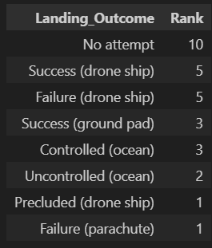
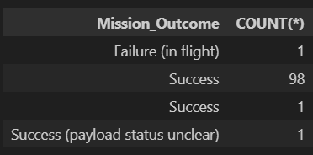
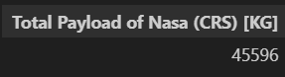
EDA with SQL
Some queries were implemented using SQL on the database. The following are key pieces of information that were gathered:
All the queries can be found on GitHub
Figure 3. Total Payload Mass transported by Nasa
Figure 1. List of Mission Outcome
Figure 2. Rank of Landing Outcome

Slide 13
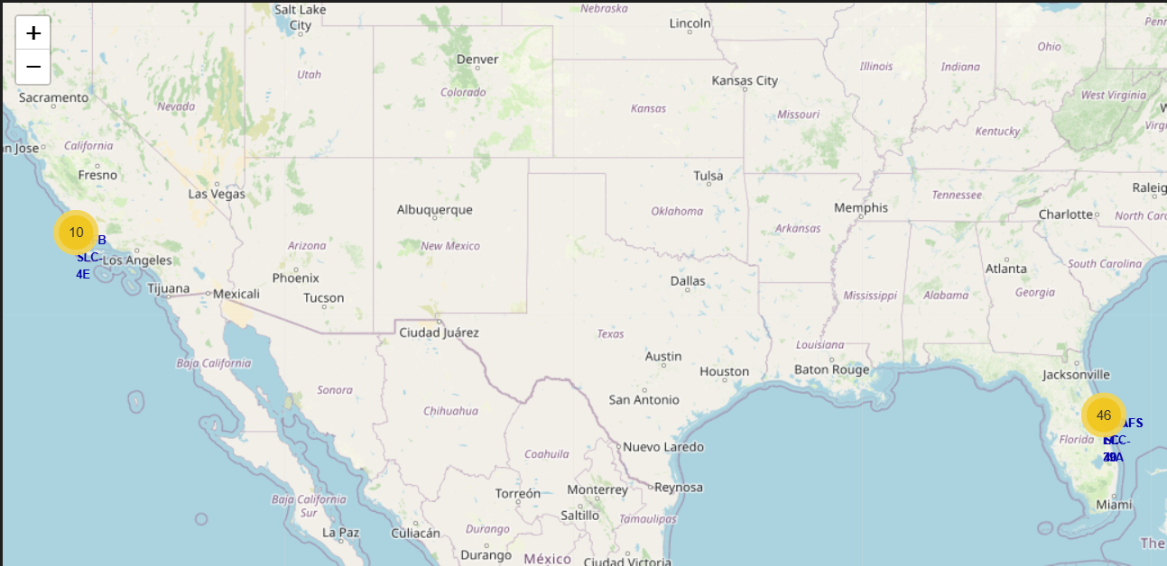
Build an Interactive Map with Folium
I create interactive Maps with folium to recognize the launch sites
To achieve this, I use markers to mark the position of the launch sites.
The markers had different color for the landing outcome, green for success, and red for failed landings.
The code can be found on GitHub

Slide 14
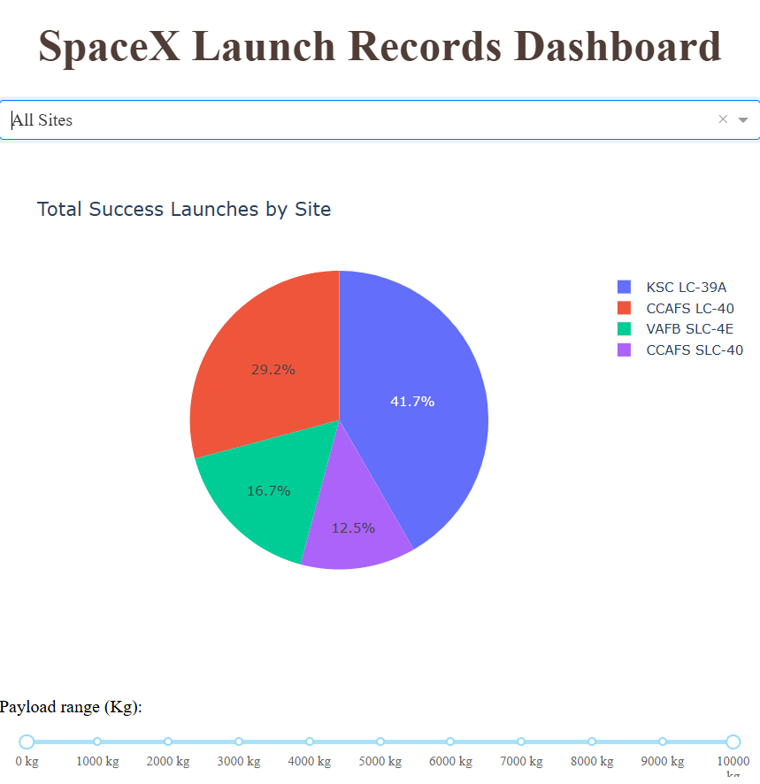
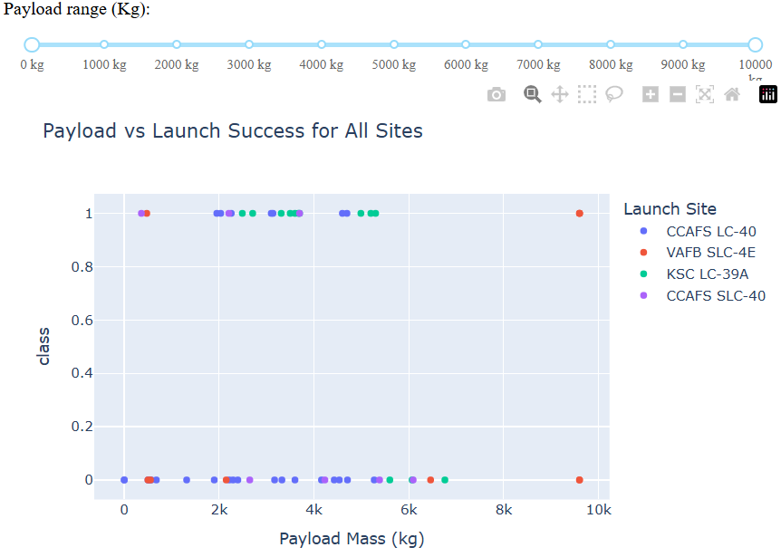
Build a Dashboard with Plotly Dash
It was created interactive visualization with Plotly Dash
The visualization consist in:
Total success launches by site
Payload Mass vs Launch success for Launch Sites

Slide 15
Predictive Analysis (Classification)
Four models were used:
Logistic Regression
SVM
Decision Tree
KNN
To compare the performance, we use the same train test split.
All the procedure can be found on GitHub.

Slide 16

Section 2

Slide 17
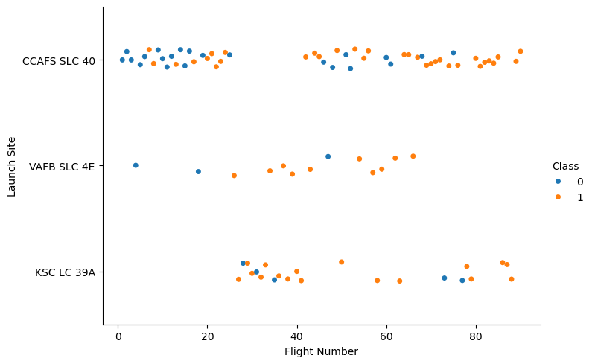
Flight Number vs. Launch Site
The launch site VAFB SLC-4E shows the lowest number of recorded launches in the dataset, suggesting limited operational use, possibly as a test site that was later decommissioned.
In contrast, CCAFS SLC-40 is the most utilized launch site, especially in the early missions. However, between flights 30 and 40, there is a noticeable decline in its usage, likely due to maintenance or upgrades. During this period, the KSC LC-39A site shows a significant increase in activity and stands out with the highest recorded success rate among all launch sites.

Slide 18
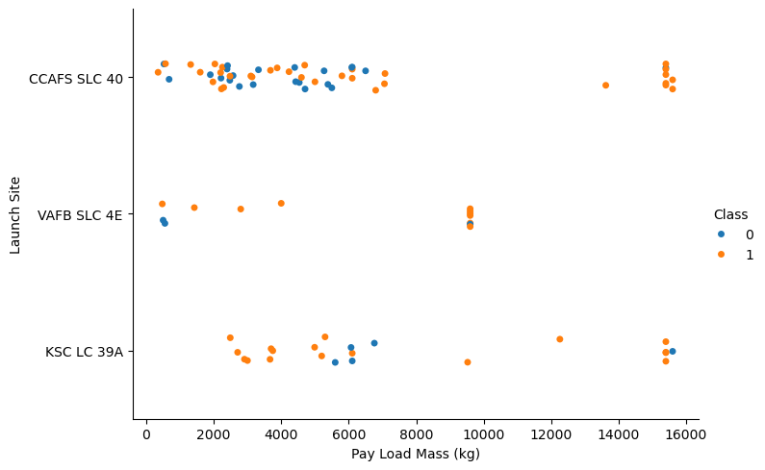
Payload vs. Launch Site
CCAFD and KSC are the only launch sites with the maximum payload mass
It can be seen some sort of trouble for the KSC launch site around the 6000kg of Payload Mass

Slide 19
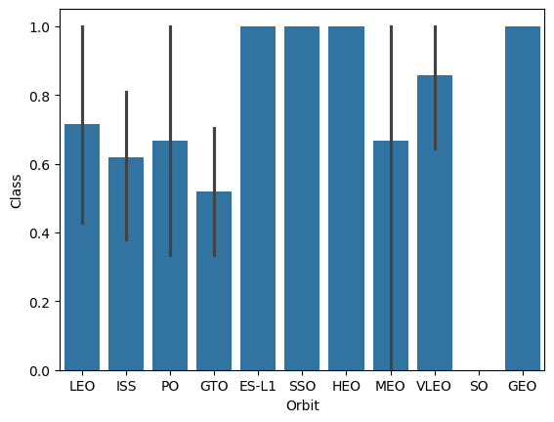
Success Rate vs. Orbit Type
The data indicates that four different orbit types achieved a 100% success rate. Among them, the Sun-Synchronous Orbit (SSO) is the only one with more than a single recorded launch, totaling five successful missions conducted between 2017 and 2020.

Slide 20
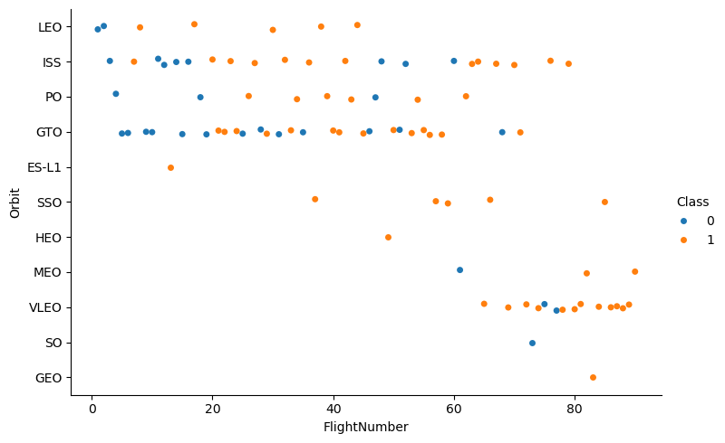
Flight Number vs. Orbit Type
The LEO orbit is the only that show a relation between the Flight Number.

Slide 21
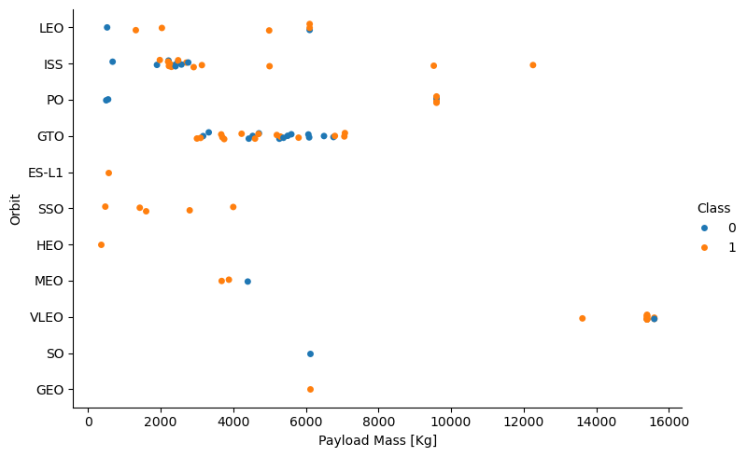
Payload vs. Orbit Type
With heavy payloads the successful landing or positive landing rate are more for Polar, LEO and ISS.
However, for GTO, it's difficult to distinguish between successful and unsuccessful landings as both outcomes are present.

Slide 22
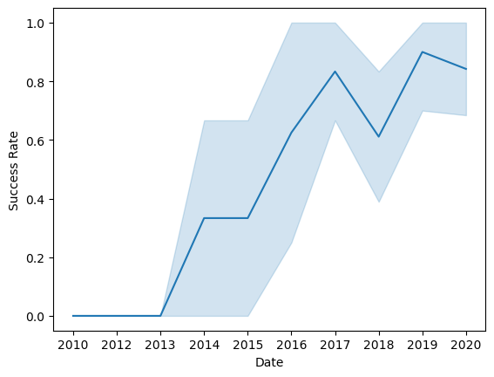
Launch Success Yearly Trend
We can see that the success rate increase since 2013
There is a minimal decrease in the year 2018

Slide 23
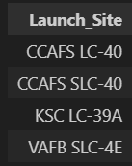
All Launch Site Names
Using SQL queries, I find the names of all the launch Sites:
CCAFS LC-40
CCAFS SLC-40
KSC LC-39A
VAFB SLC-4E

Slide 24
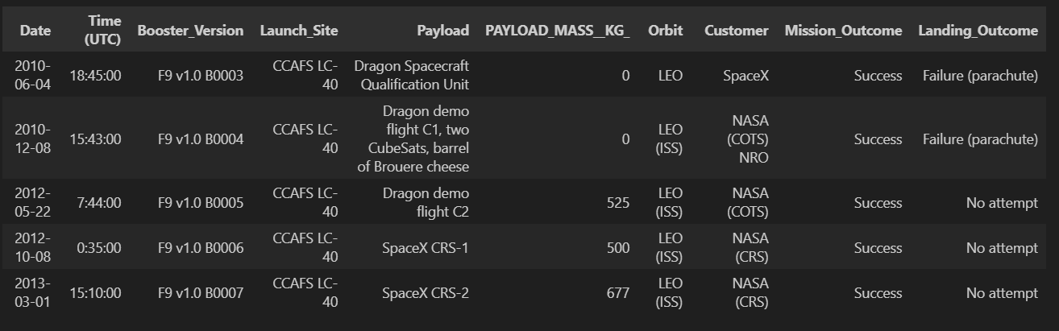
Launch Site Names Begin with 'CCA'
To see the format of the Dataset, I query the information of the launche sites that begin with ‘CCA’
In the previous query we see that are only two site that begin with CCA: CCAFS LC-40 and CCAFS SLC-40

Slide 25
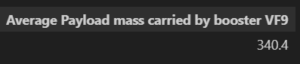
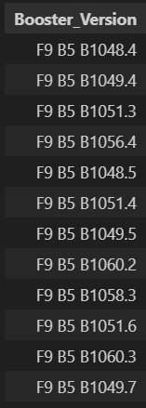

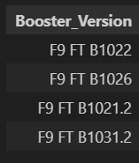
Other minor queries
The total payload carried by boosters from NASA
Date of the first successful landing in ground pad
Booster which have success landing and have a payload between 4000 and 6000kg
All the booster_versions that have carried the maximum payload mass.

Slide 26
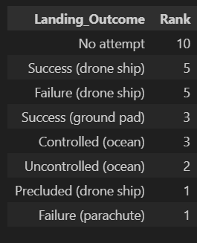
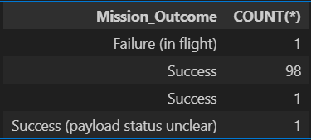
Rank Landing Outcomes Between 2010-06-04 and 2017-03-20
Rank the count of landing outcomes (such as Failure (drone ship) or Success (ground pad)) between the date 2010-06-04 and 2017-03-20, in descending order
List the total number of successful and failure mission outcomes

Slide 27

Section 3

Slide 28
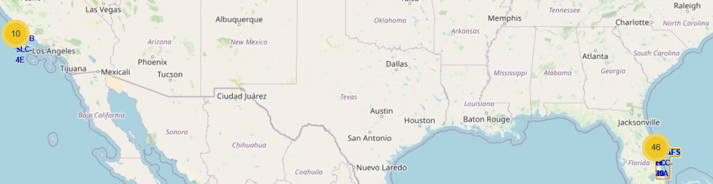
Position of all the launch sites
We can see how the launch sites are divided into two groups, one in california and the other in Florida

Slide 29
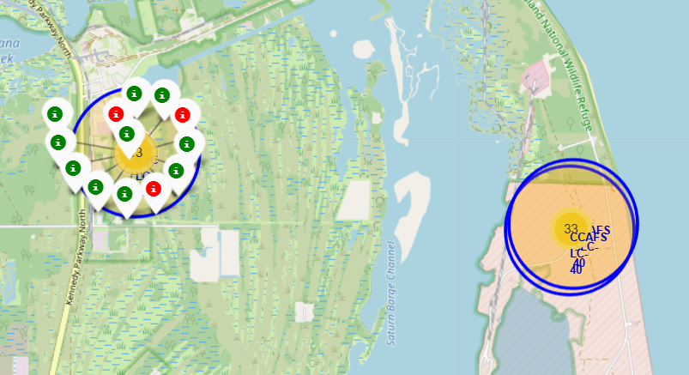
Marker Styles
The marker are green for the Success landings, and red for the failed landing

Slide 30
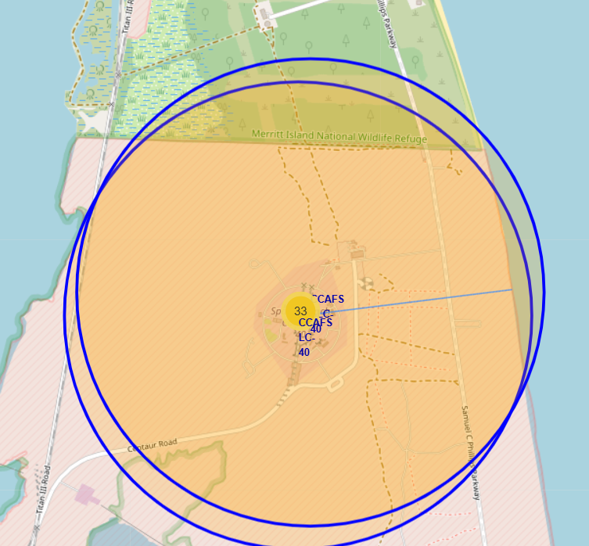
Coastline distance from the launch site
In the Figure we can see how close is the coastline from the launch site

Slide 31

Section 4

Slide 32
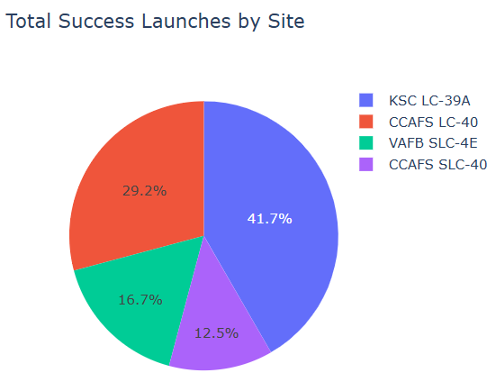
Success Launches by Site
In the Pie Chart we can see the percentage of success launches of all the launch site.
The site with mire success launches is the KSC LC-39A with 10 launches.

Slide 33
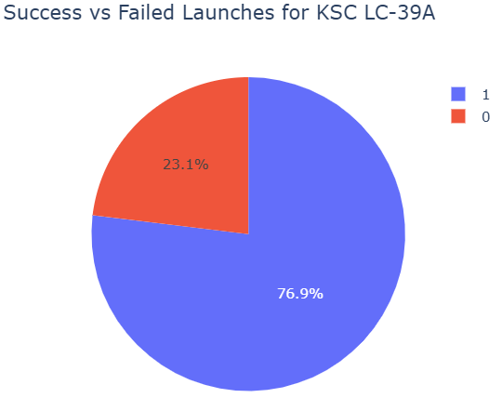
Launch Site with more success
The KSC LC-39A has the highest success rate, with
10 success launches
3 failed launches

Slide 34
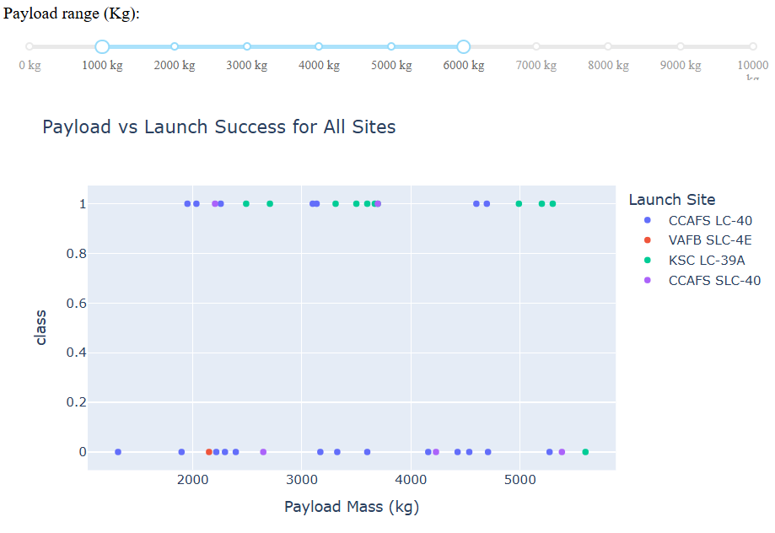
Correlation of payload and Launch Succes
We can see the predominance of KSC LC-39A Launch site on the success class.

Slide 35

Section 5

Slide 36
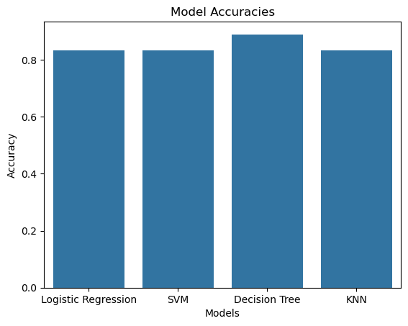
Classification Accuracy
In the bar chart we can see the accuracies for all the models.
The Decision Tree has the higher accuracy with 88,88%

Slide 37

Confusion Matrix for the decision tree
This is de Confusion Matrix for the decision tree
The confusion matrix shows that the decision tree classifier performs well, with a high number of correct predictions along the diagonal and relatively few misclassifications. This indicates that the model is effectively capturing the underlying patterns in the data.

Slide 38
Conclusions
The Decision Tree model achieved the highest accuracy among the tested models, with a score of 88.9%.
The EDA suggests that technological advancement over time is a key factor contributing to mission success. This is supported by the Flight Number, which shows the strongest correlation with other variables.
The KSC LC-39A launch site appears promising due to its high success rate; however, its significance is limited by the relatively small sample size of only 13 recorded landings.

Slide 39


